Slide 1
Communication
UART, i2c, SPI

Slide 2
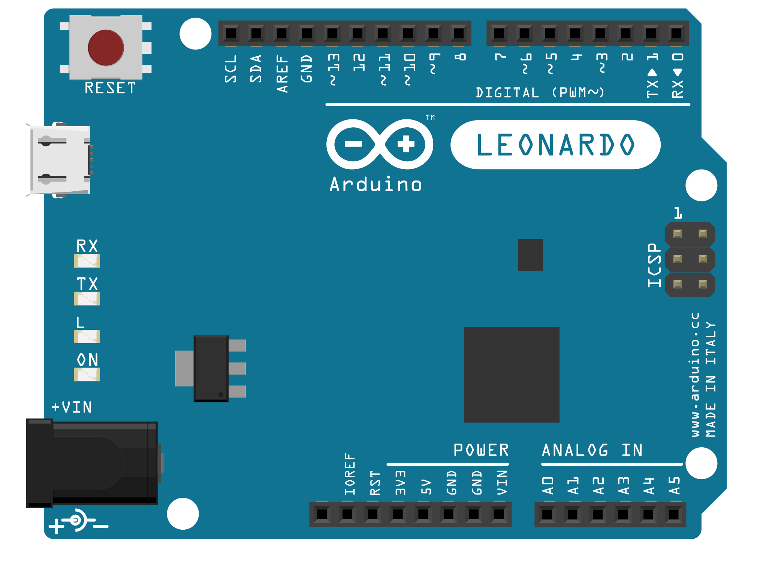

Slide 3
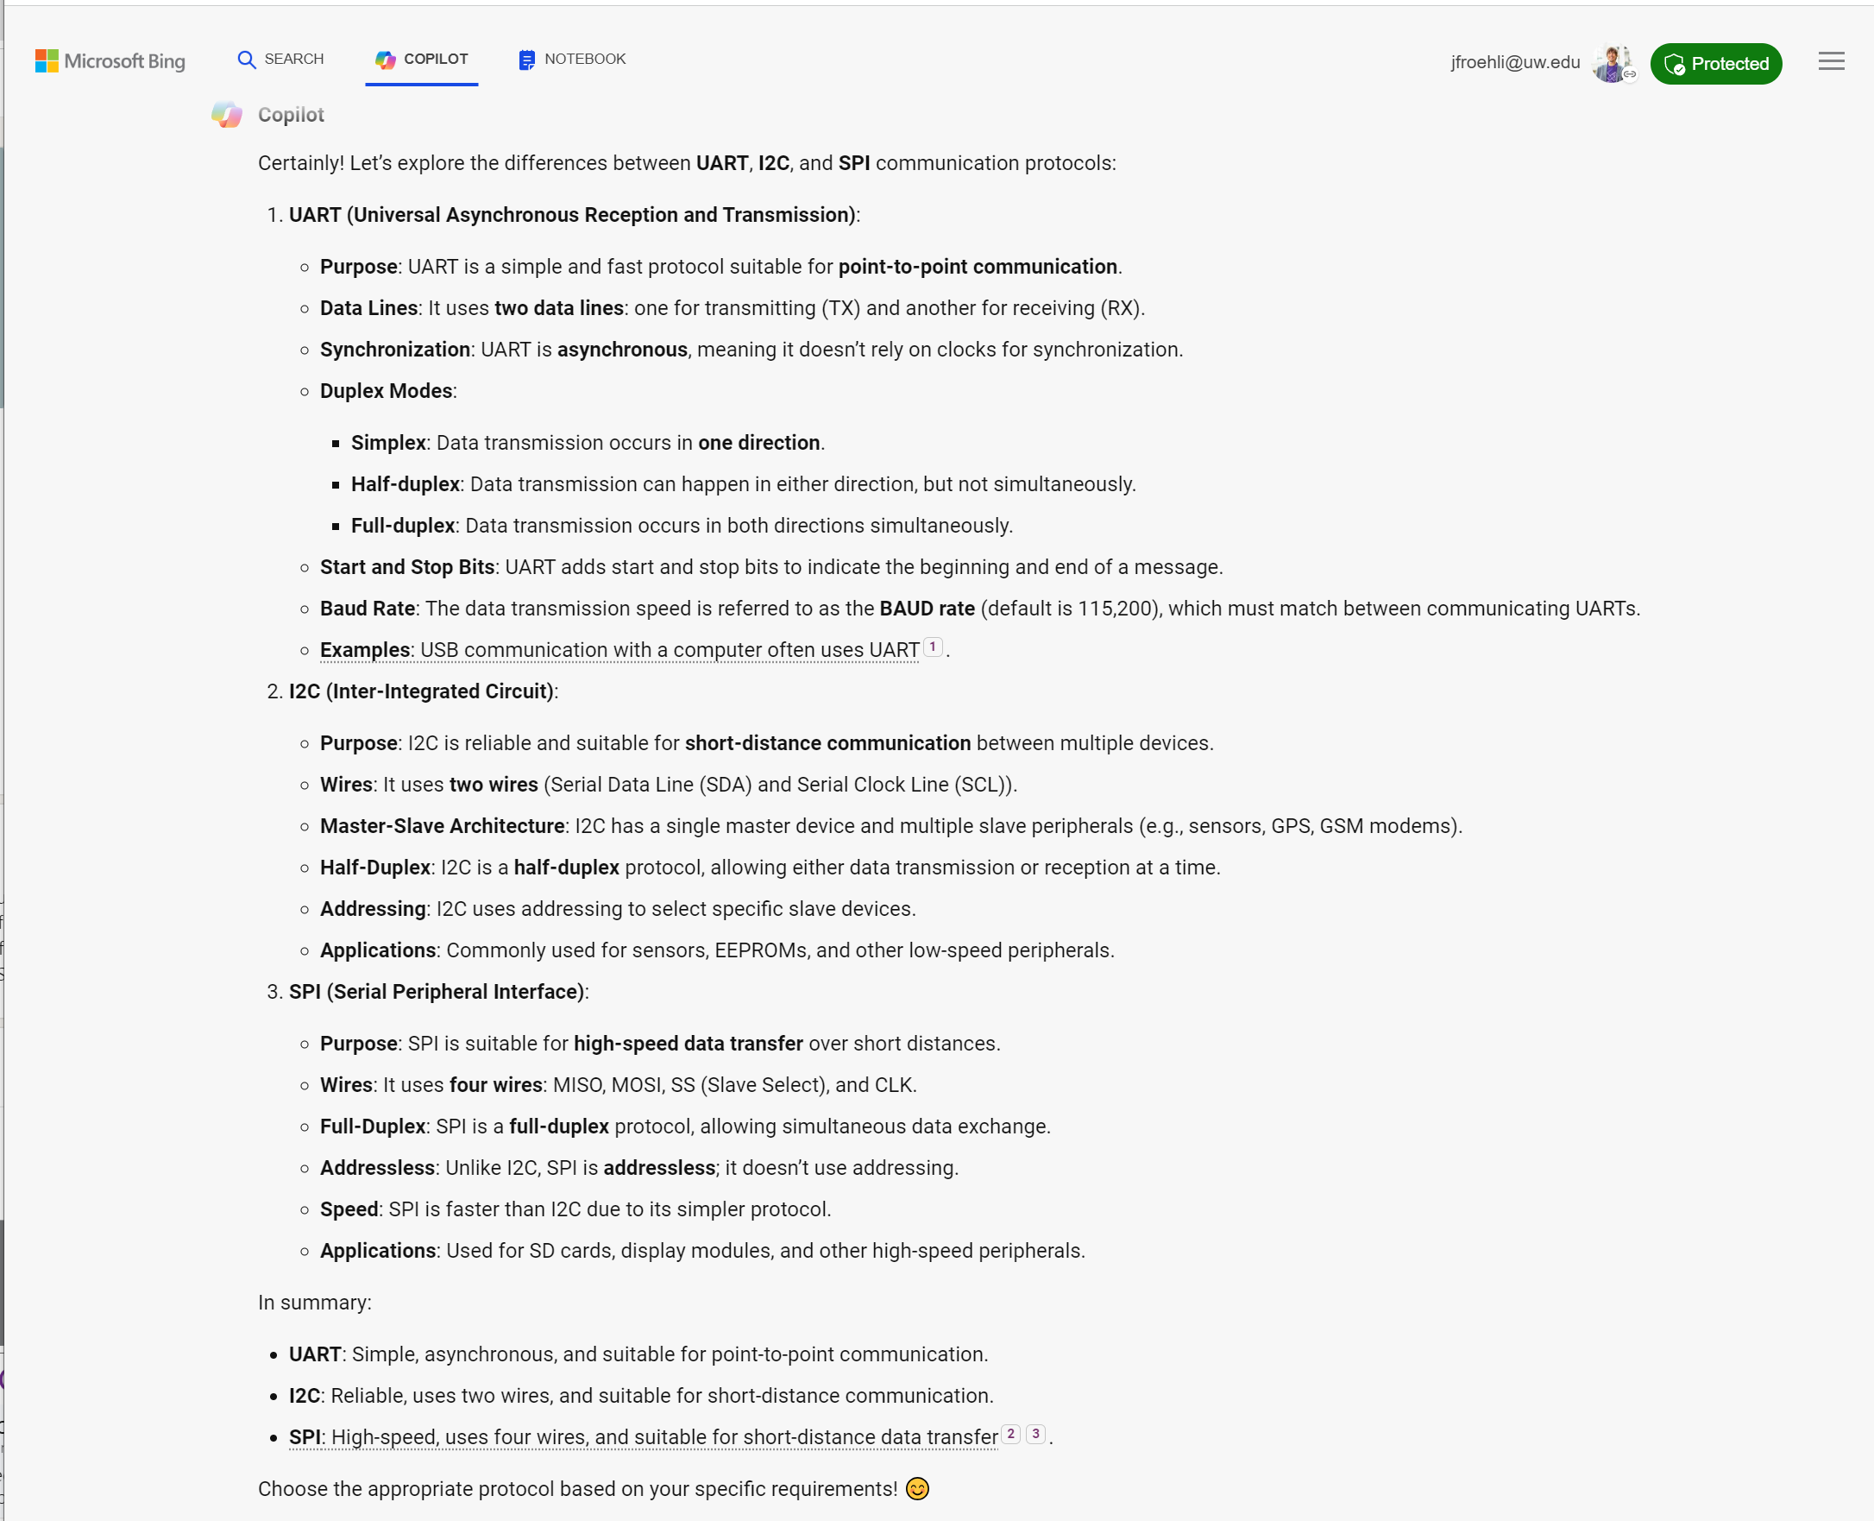

Slide 4
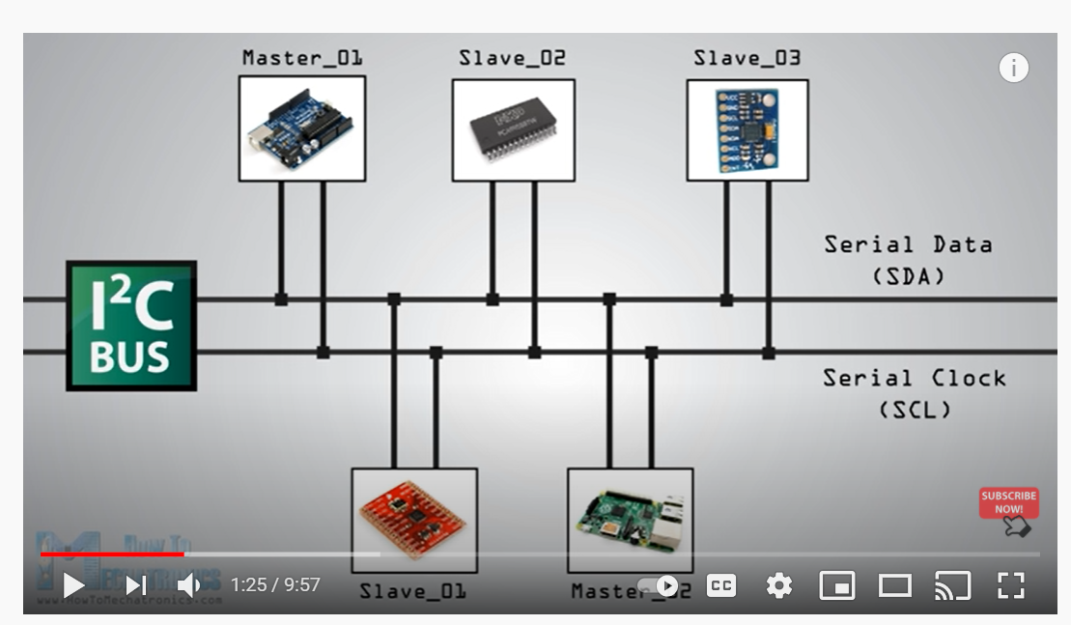
Make a diagram like:
https://youtu.be/6IAkYpmA1DQ
Notes:
https://youtu.be/6IAkYpmA1DQ
How I2C Communication Works and How To Use It with Arduino
How to Mechatronics

Slide 5
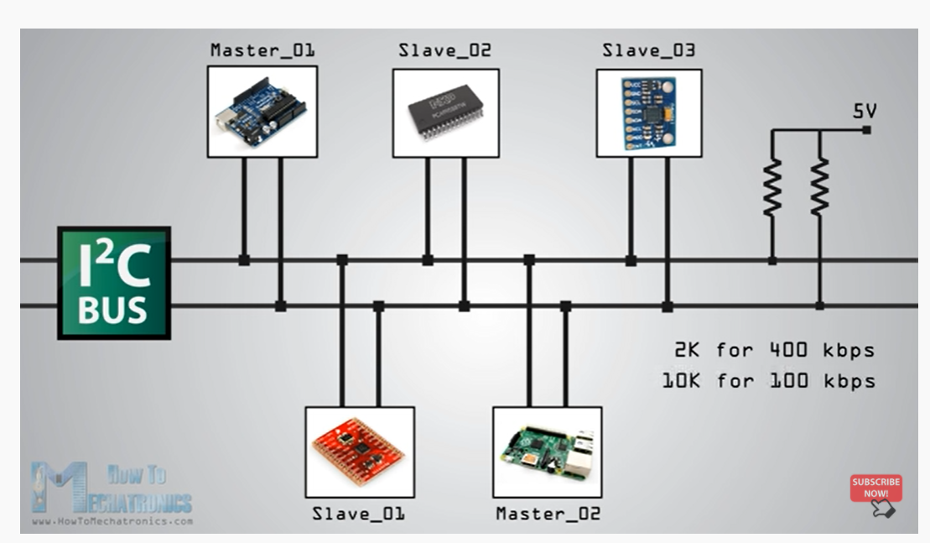
Notes:
https://youtu.be/6IAkYpmA1DQ?t=116

Slide 6
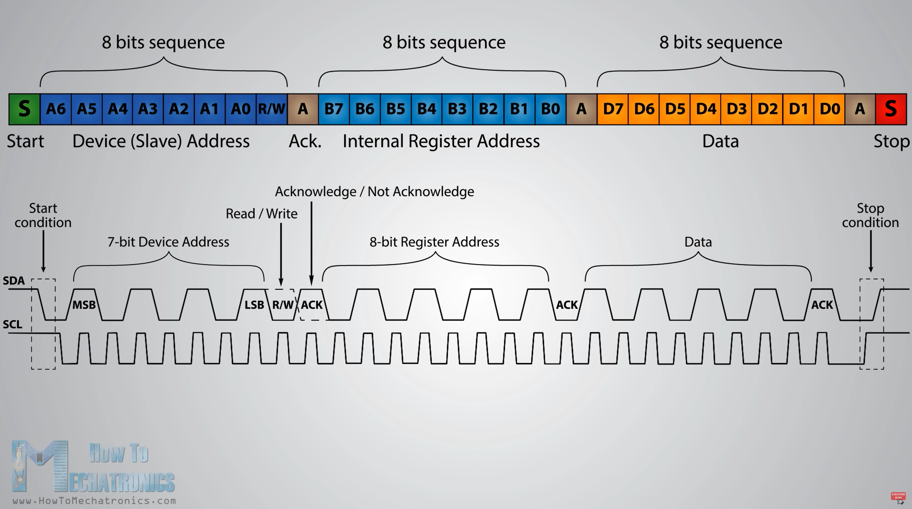

Slide 7
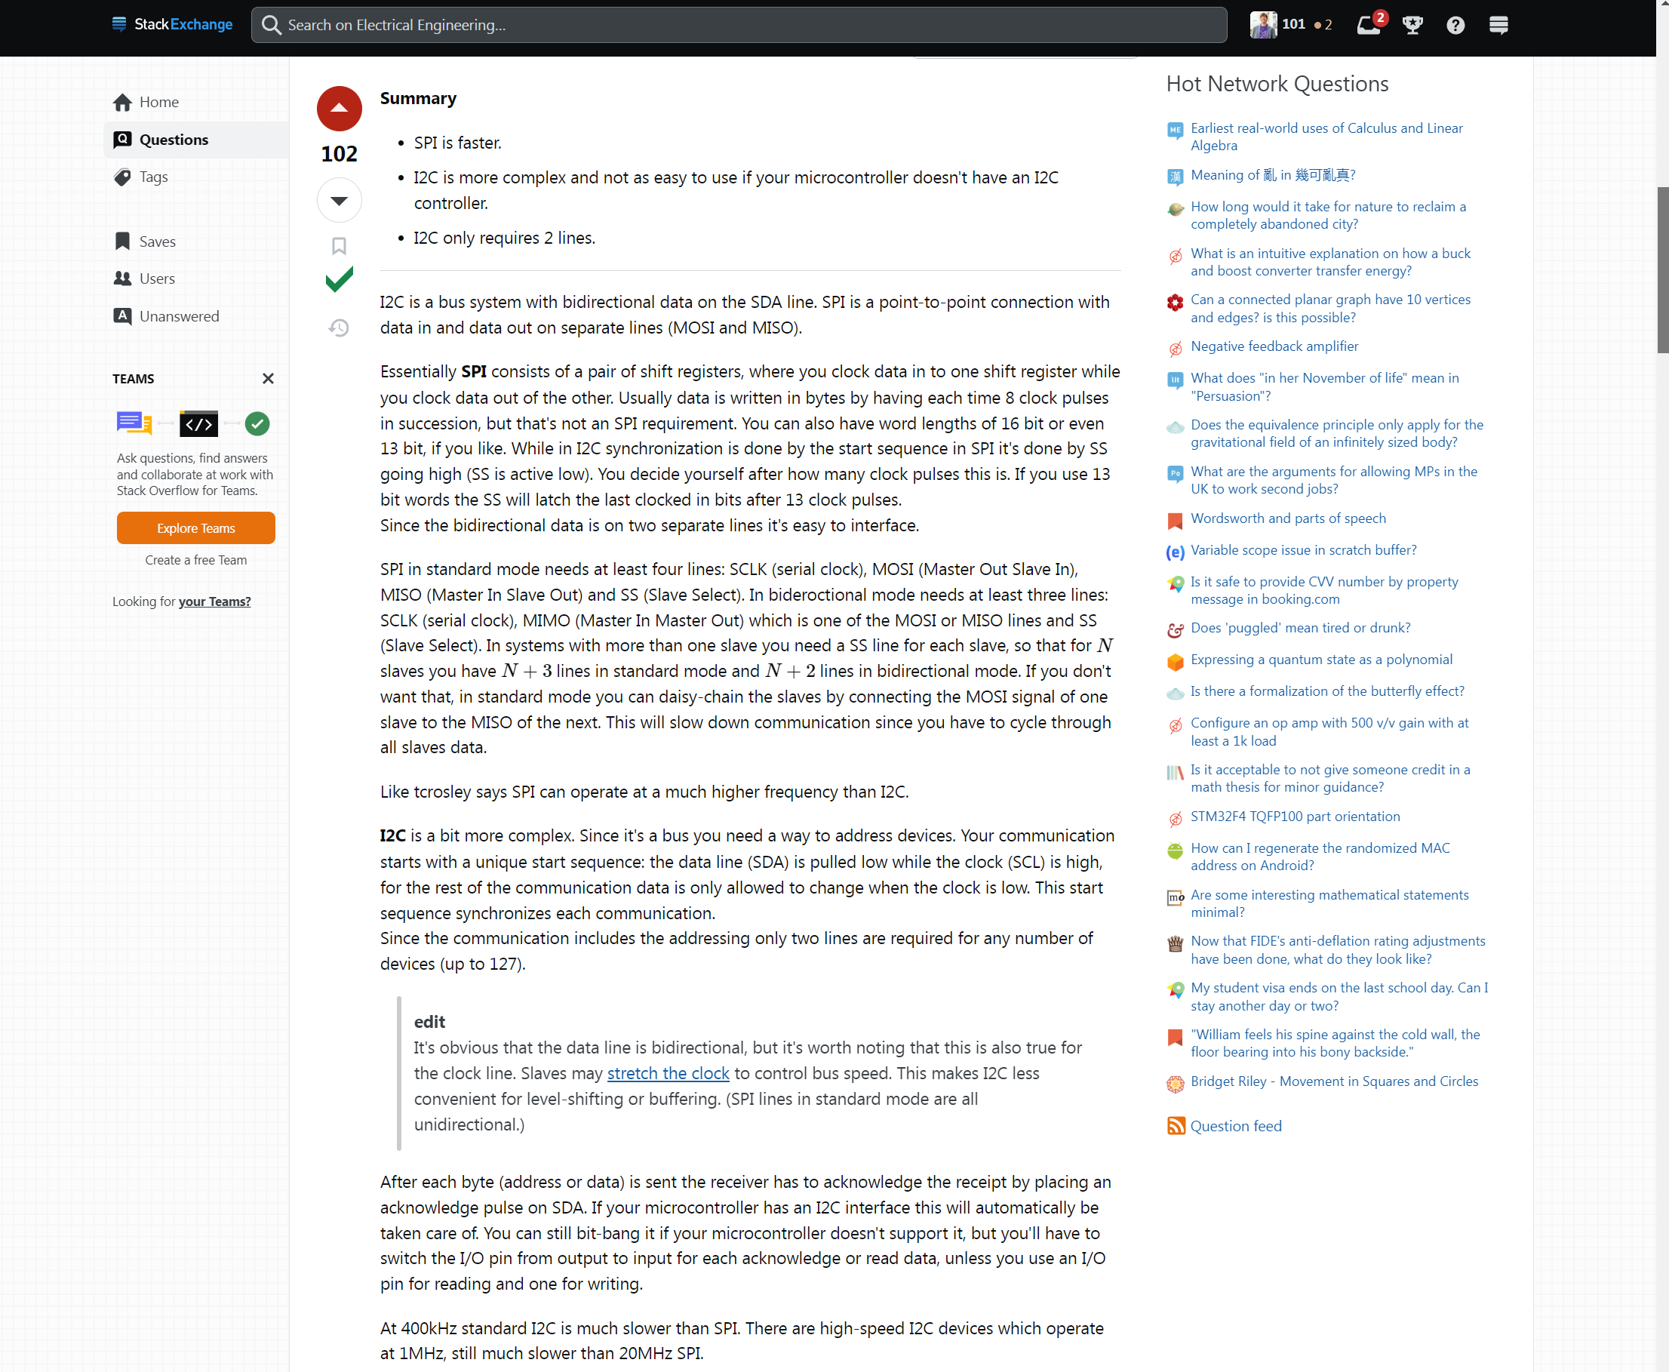
Notes:
https://electronics.stackexchange.com/questions/29037/tradeoffs-when-considering-spi-or-i2c

Slide 8
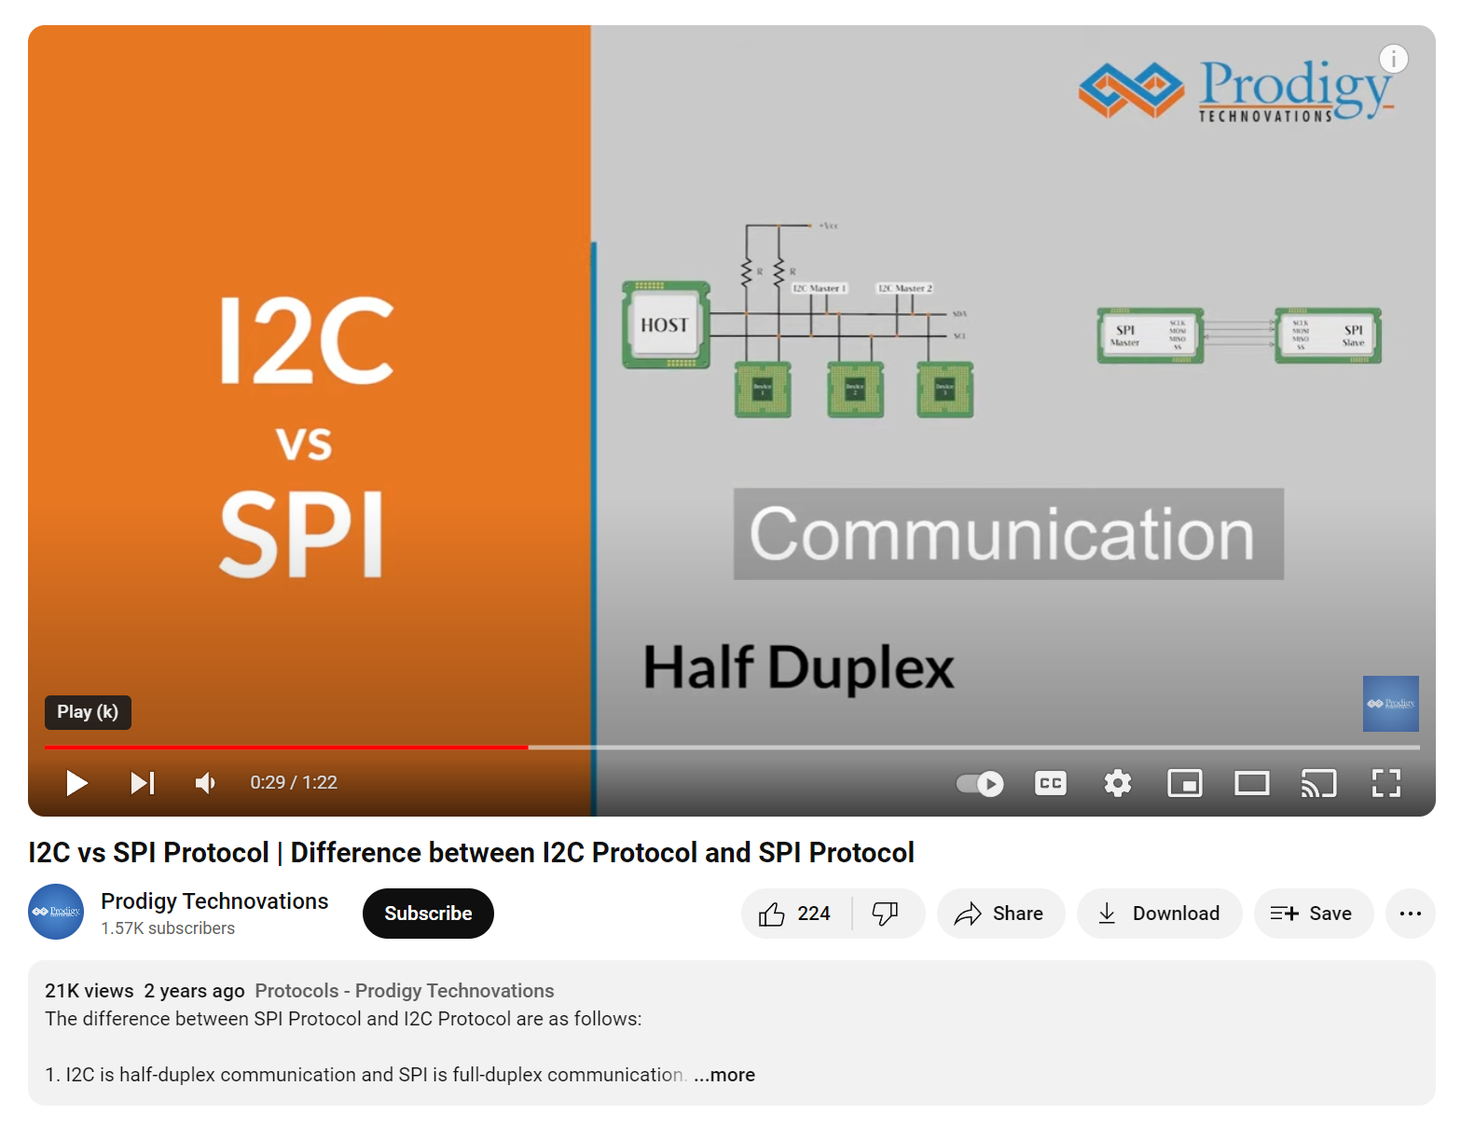
Differences
i2c is half duplex communication
SPI is full duplex
i2c supports multi-master & slave
SPI supports single master
i2c is a two-wire protocol: data + clock
SPI is a four-wire protocol
i2c supports clock stretching
i2c is slower than SPI
i2c has extra overhead start and stop bits
i2c has an ack bit after every byte of transfer
Notes:
https://youtu.be/iKDeJi2VBNo?si=ctX-JMHOFuZ8NUPL

Slide 9
